Slide 1

ANALYTICAL STORYTELLING: LENDING CLUB LOAN DATA
Victoria Fadekemi Ojo
ISOM 837- AE Data Mining to Business Insights

Slide 2
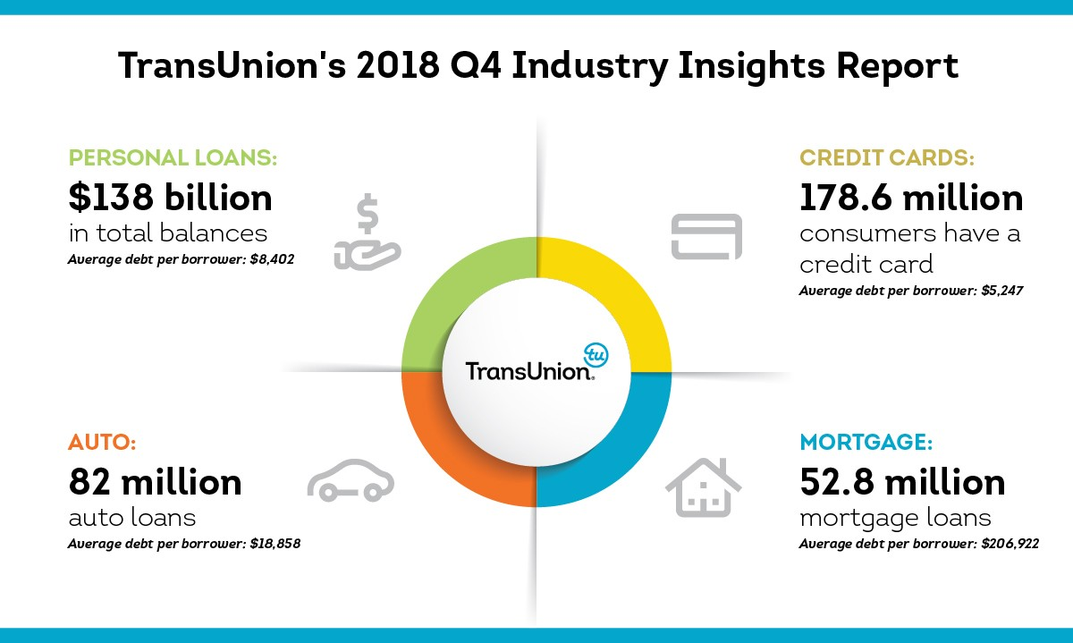
BUSINESS UNDERSTANDING
Lending Club is a peer-to-peer lending platform that helps investors and borrowers, who are individuals or small enterprises, make loans to one another. Loans for personal, company, or debt consolidation are available to borrowers, and investors are willing to support these loans in exchange for possible profits.
Based on each applicant's credit profile and risk assessment, it provides competitive rates. Incentives can be as low as 6.95%, depending on your credit score. The Lending Club makes use of data-driven models and proprietary technology to assess each borrower's credit risk and ability to repay.
They still experienced problems with fraud, subpar underwriting and a dearth of loan performance transparency. In 2009, they halted new loan originations for three months in order to improve its underwriting procedures and models but loan defaults still remained inevitable.
Research from Trans Union shows a significant increase in debts for various reasons which includes personal loans, auto loans, credit cards and mortgage loans.
Average debt per borrower for personal loans is $8,402.
Average debt per borrower for Auto loans is $18,858.
Average debt per borrower for Credit Cards is $5,247.
Average debt per borrower for Mortgage loans is $206,922.

Slide 3
DATA UNDERSTANDING
The Lending Club Loan data set contains information on borrowers from the year 2007-2010. It shows historical data on loan applications and performance, which may be utilized to forecast default risk on the basis of different loan qualities and application aspects.
The data set includes 9,579 rows and 14 columns including variables:
Credit Policy | Purpose | Interest Rate | Installment | Log annual Income.
FICO | The days with credit line | Not Fully Paid (Target) | Revolving Balance | Revol util
Inq Final 6 Months | Deling 2 years | Pub Rec | DTI

Slide 4

DATA PREPARATION
No missing values
The five most important variables according to variable worth are interest rate, inq_last_6_months, credit Policy , Fico, and revol_util.
Skewness- Revol_bal is positively skewed with a skew statistic of 11.16106.
The skew statistics of the other variables, such as installment, int_rate, and dti, are closer to 0, suggesting a more symmetrical distribution.

Slide 5
Model Comparison
Target variable "not fully paid" was analyzed to predict its influencing factors.
5 Different models were used which includes: Decision Tree, Regression, Stepwise Regression, Forward Regression, Backward Regression and Neural Network using 60 for Training and 40 for Validation.
The Regression model was found to be the best based on its low misclassification rate and low Root Average Squared Error.
No overfitting was also observed in the results.
Variable | Estimate
Intercept | 2.0698
Credit Policy | 0.1578
Days_with_cr_line | 3.46
Deling_2yrs | 3.0271
Dti | -0.00249
Fico | -0.00782
Ing_last_6mnths | 0.0794

Slide 6
Conclusion & Recommendations
The analysis therefore shows that delinq 2 years has the most effect on the total amount of loan debts that are not fully paid.
The Lending Club could avoid this by doing the following:
Utilizing delinq.2yrs as a primary predictor, create rigorous credit risk models to identify candidates who pose a high risk. Refrain from granting loans to applicants who have a history of repeated late payments.
To lessen risk, lower the maximum permitted debt-to-income (DTI) ratios for debtors who have a history of late payments.
Require higher minimum loan amounts or down payments from applicants who have a history of late payments.
Portfolio restrictions should be set based on the percentage of loans granted with material delinq.2 years.
Reduce the maximum loan periods for customers with greater debt levels by two years in order to expedite loan repayment.

Slide 7

Limitations
Since the data only goes as far back as 2010, it does not account for more recent economic situations and underwriting methods.
If loans are not followed through to the end of the payback period, the delinquency or default status might not be updated completely.
Application data that is self-reported may contain biases, mistakes, or unverifiable falsifications.

Slide 8


Slide 9
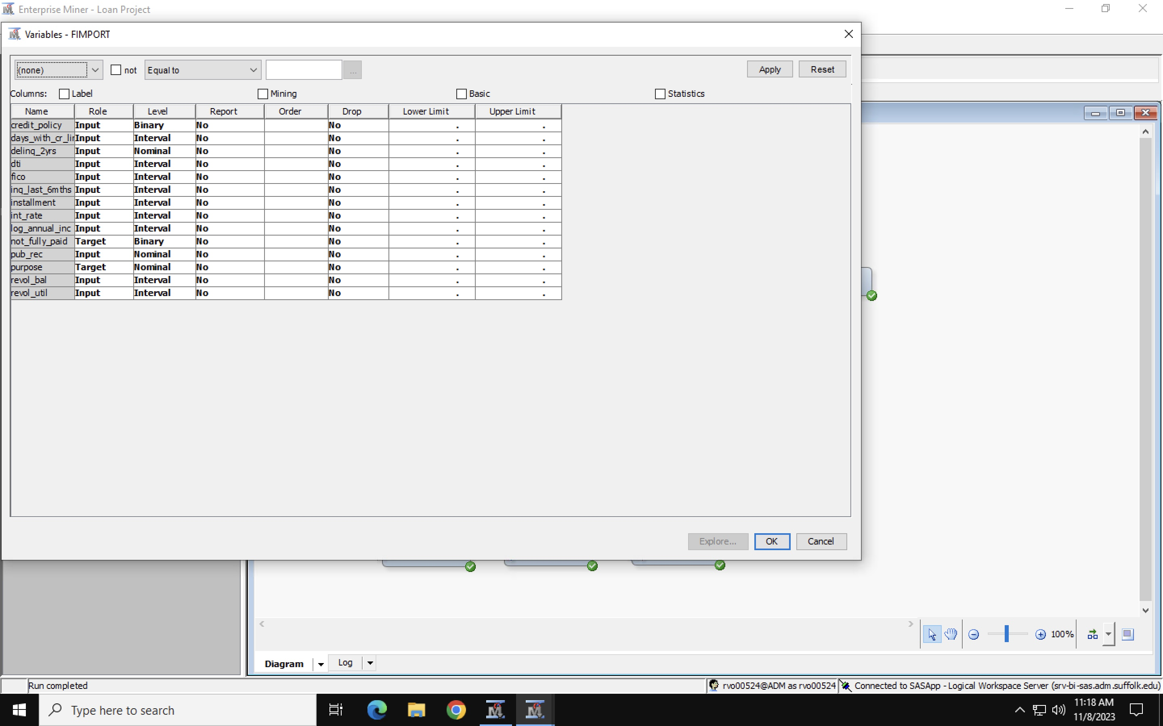
Appendix Dataset Link:
https://www.kaggle.com/datasets/itssuru/loan-data/data
Figure 1: Showing Variable Description

Slide 10
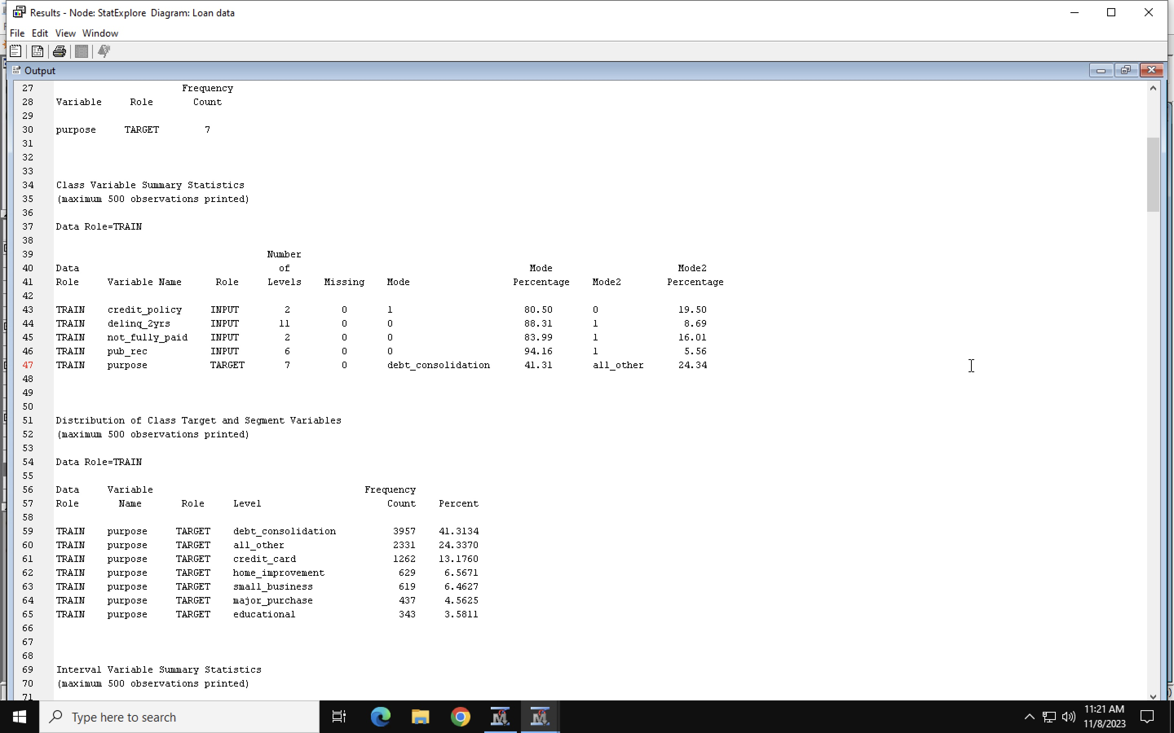
Stat Explore
Figure 2: Showing Class Variables

Slide 11
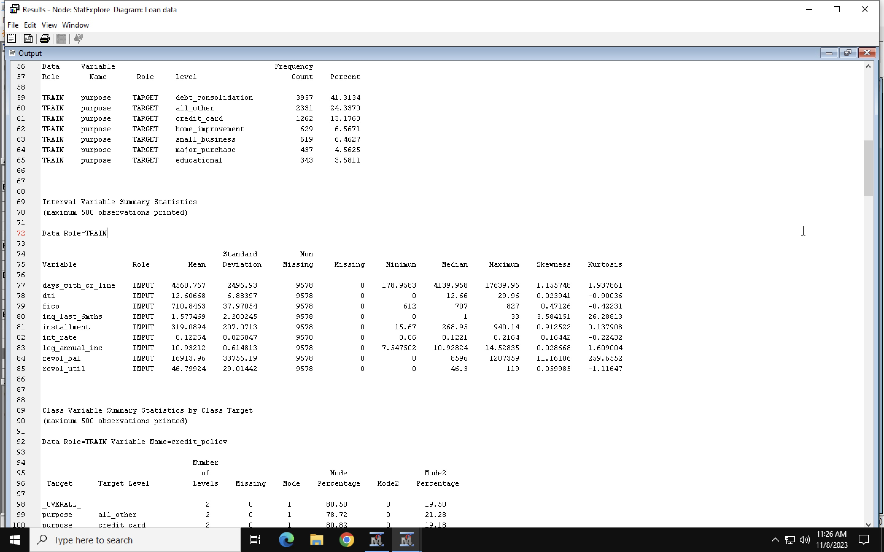
Interval Variables
Figure 3: Showing Interval Variables

Slide 12
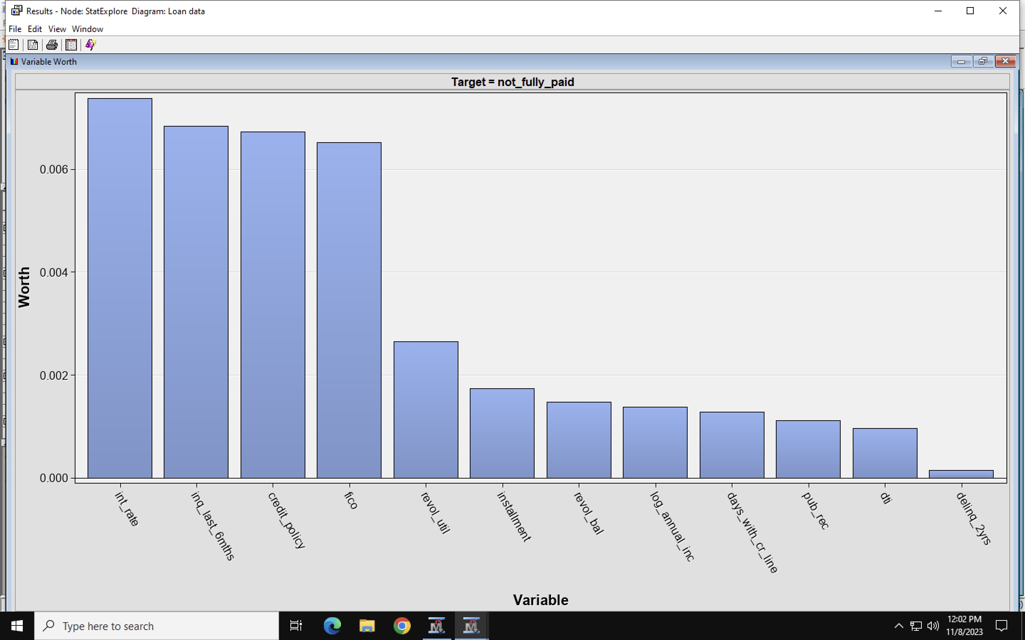
Figure 4: Showing Variable Worth

Slide 13
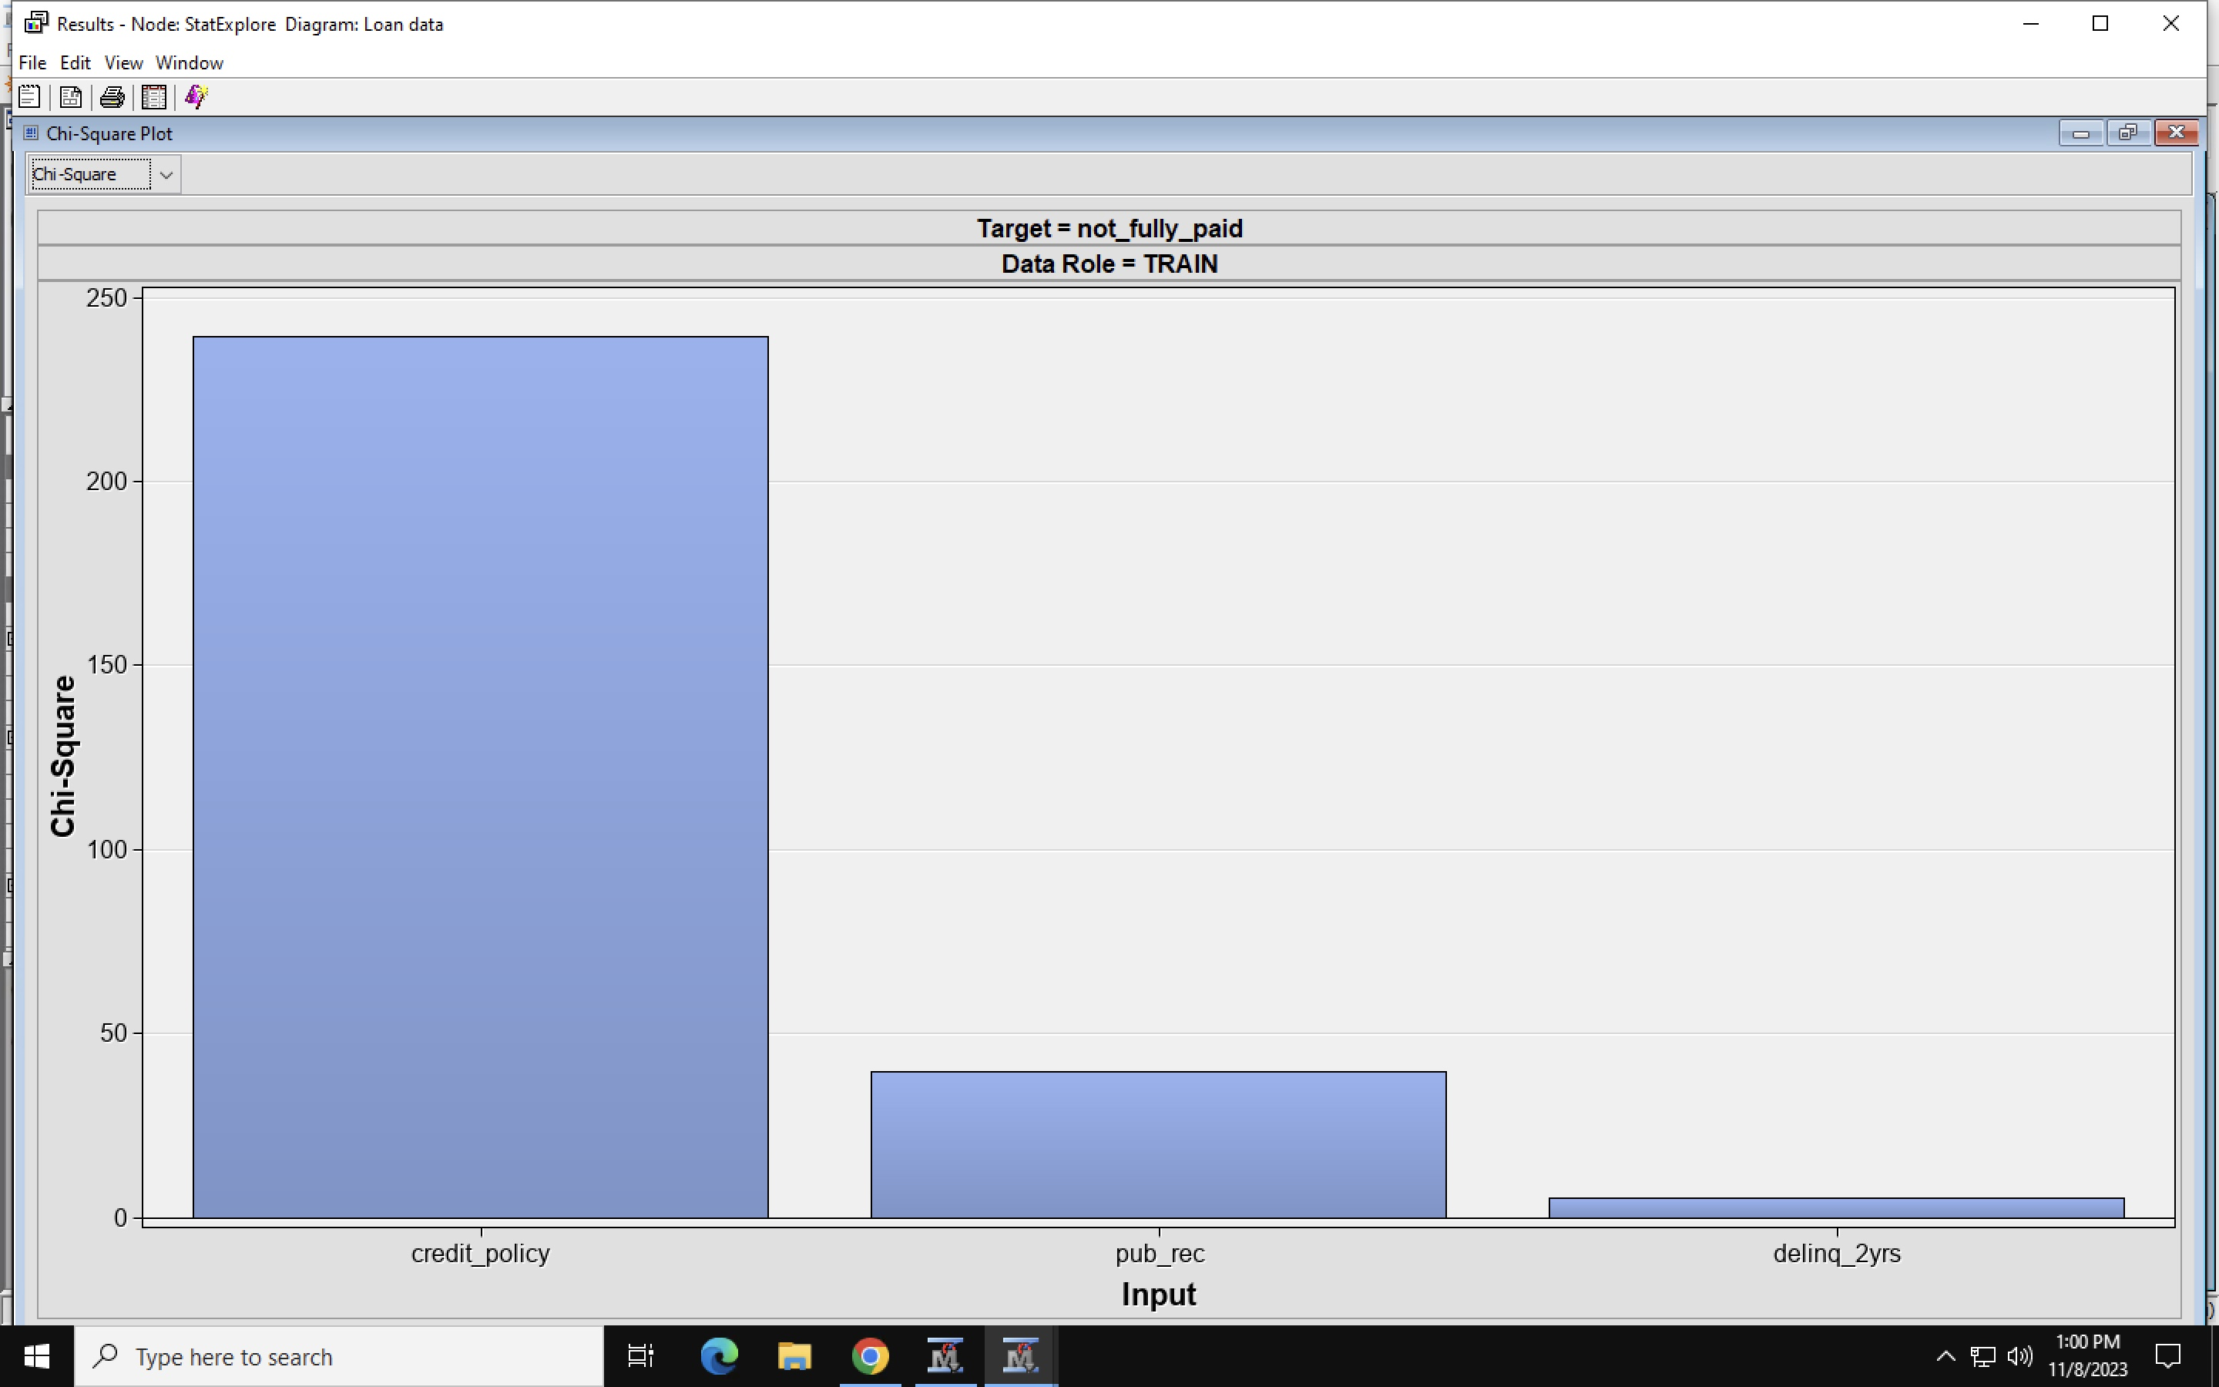
Figure 5: Showing Chi-Square Plot

Slide 14
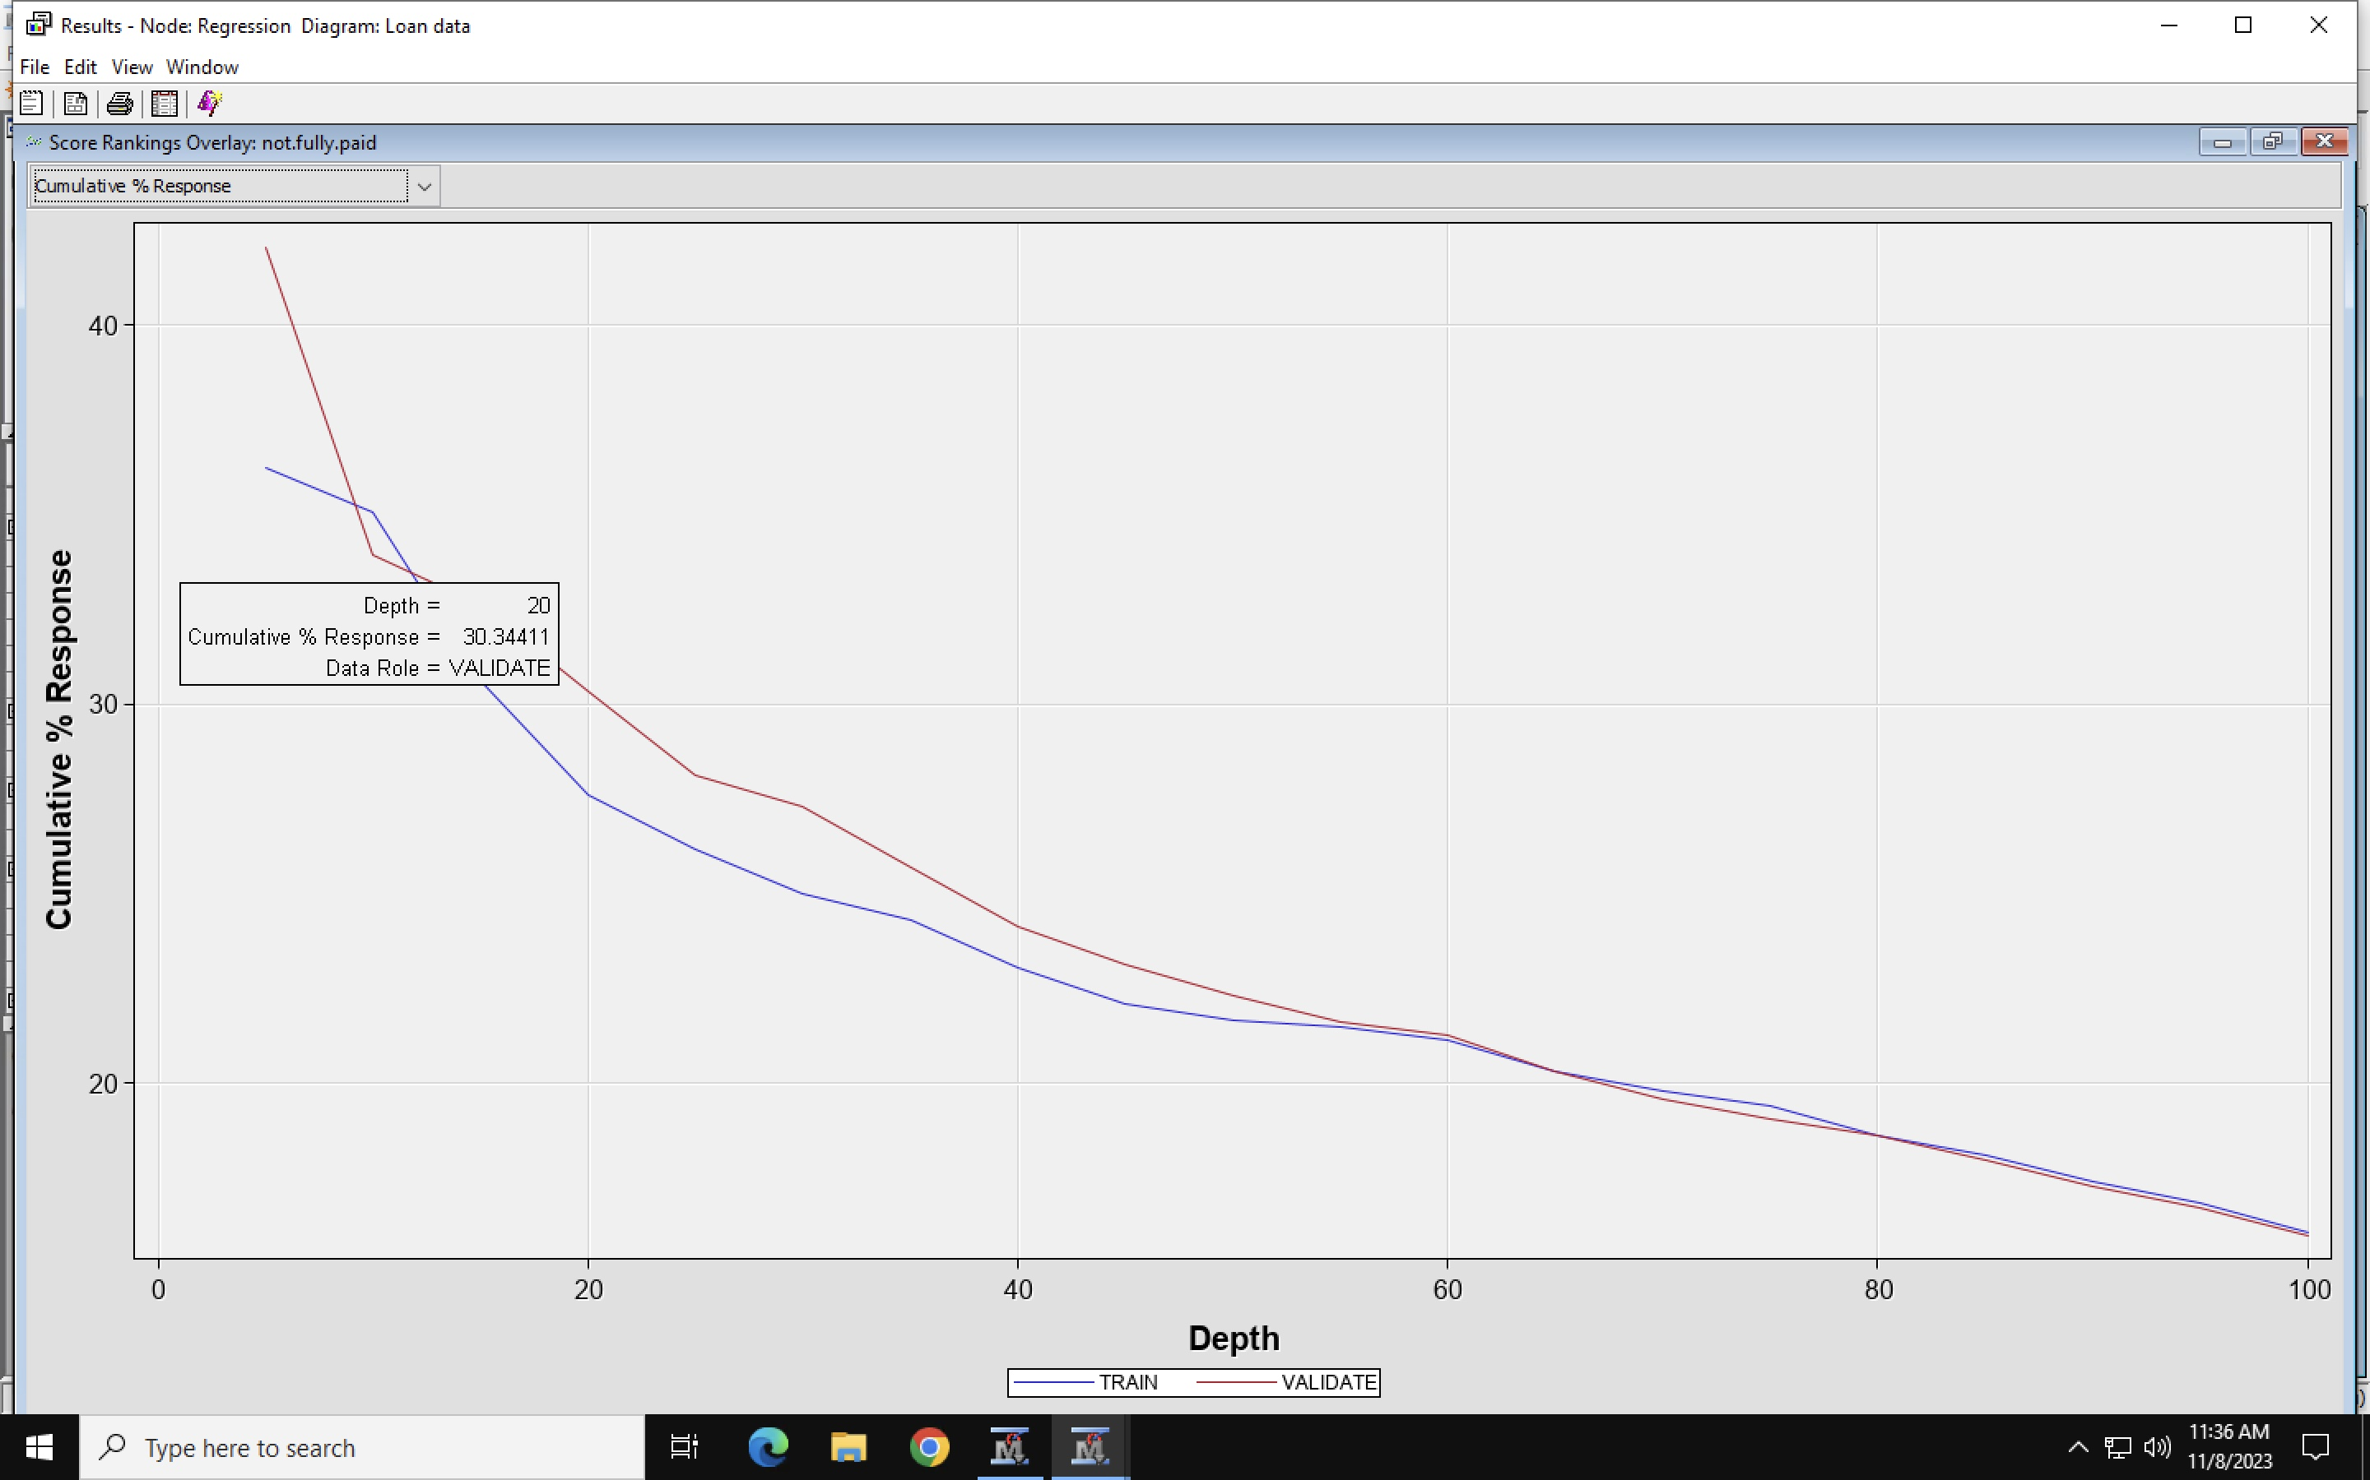
Figure 6: Regression analysis- Score Rankings overlay

Slide 15
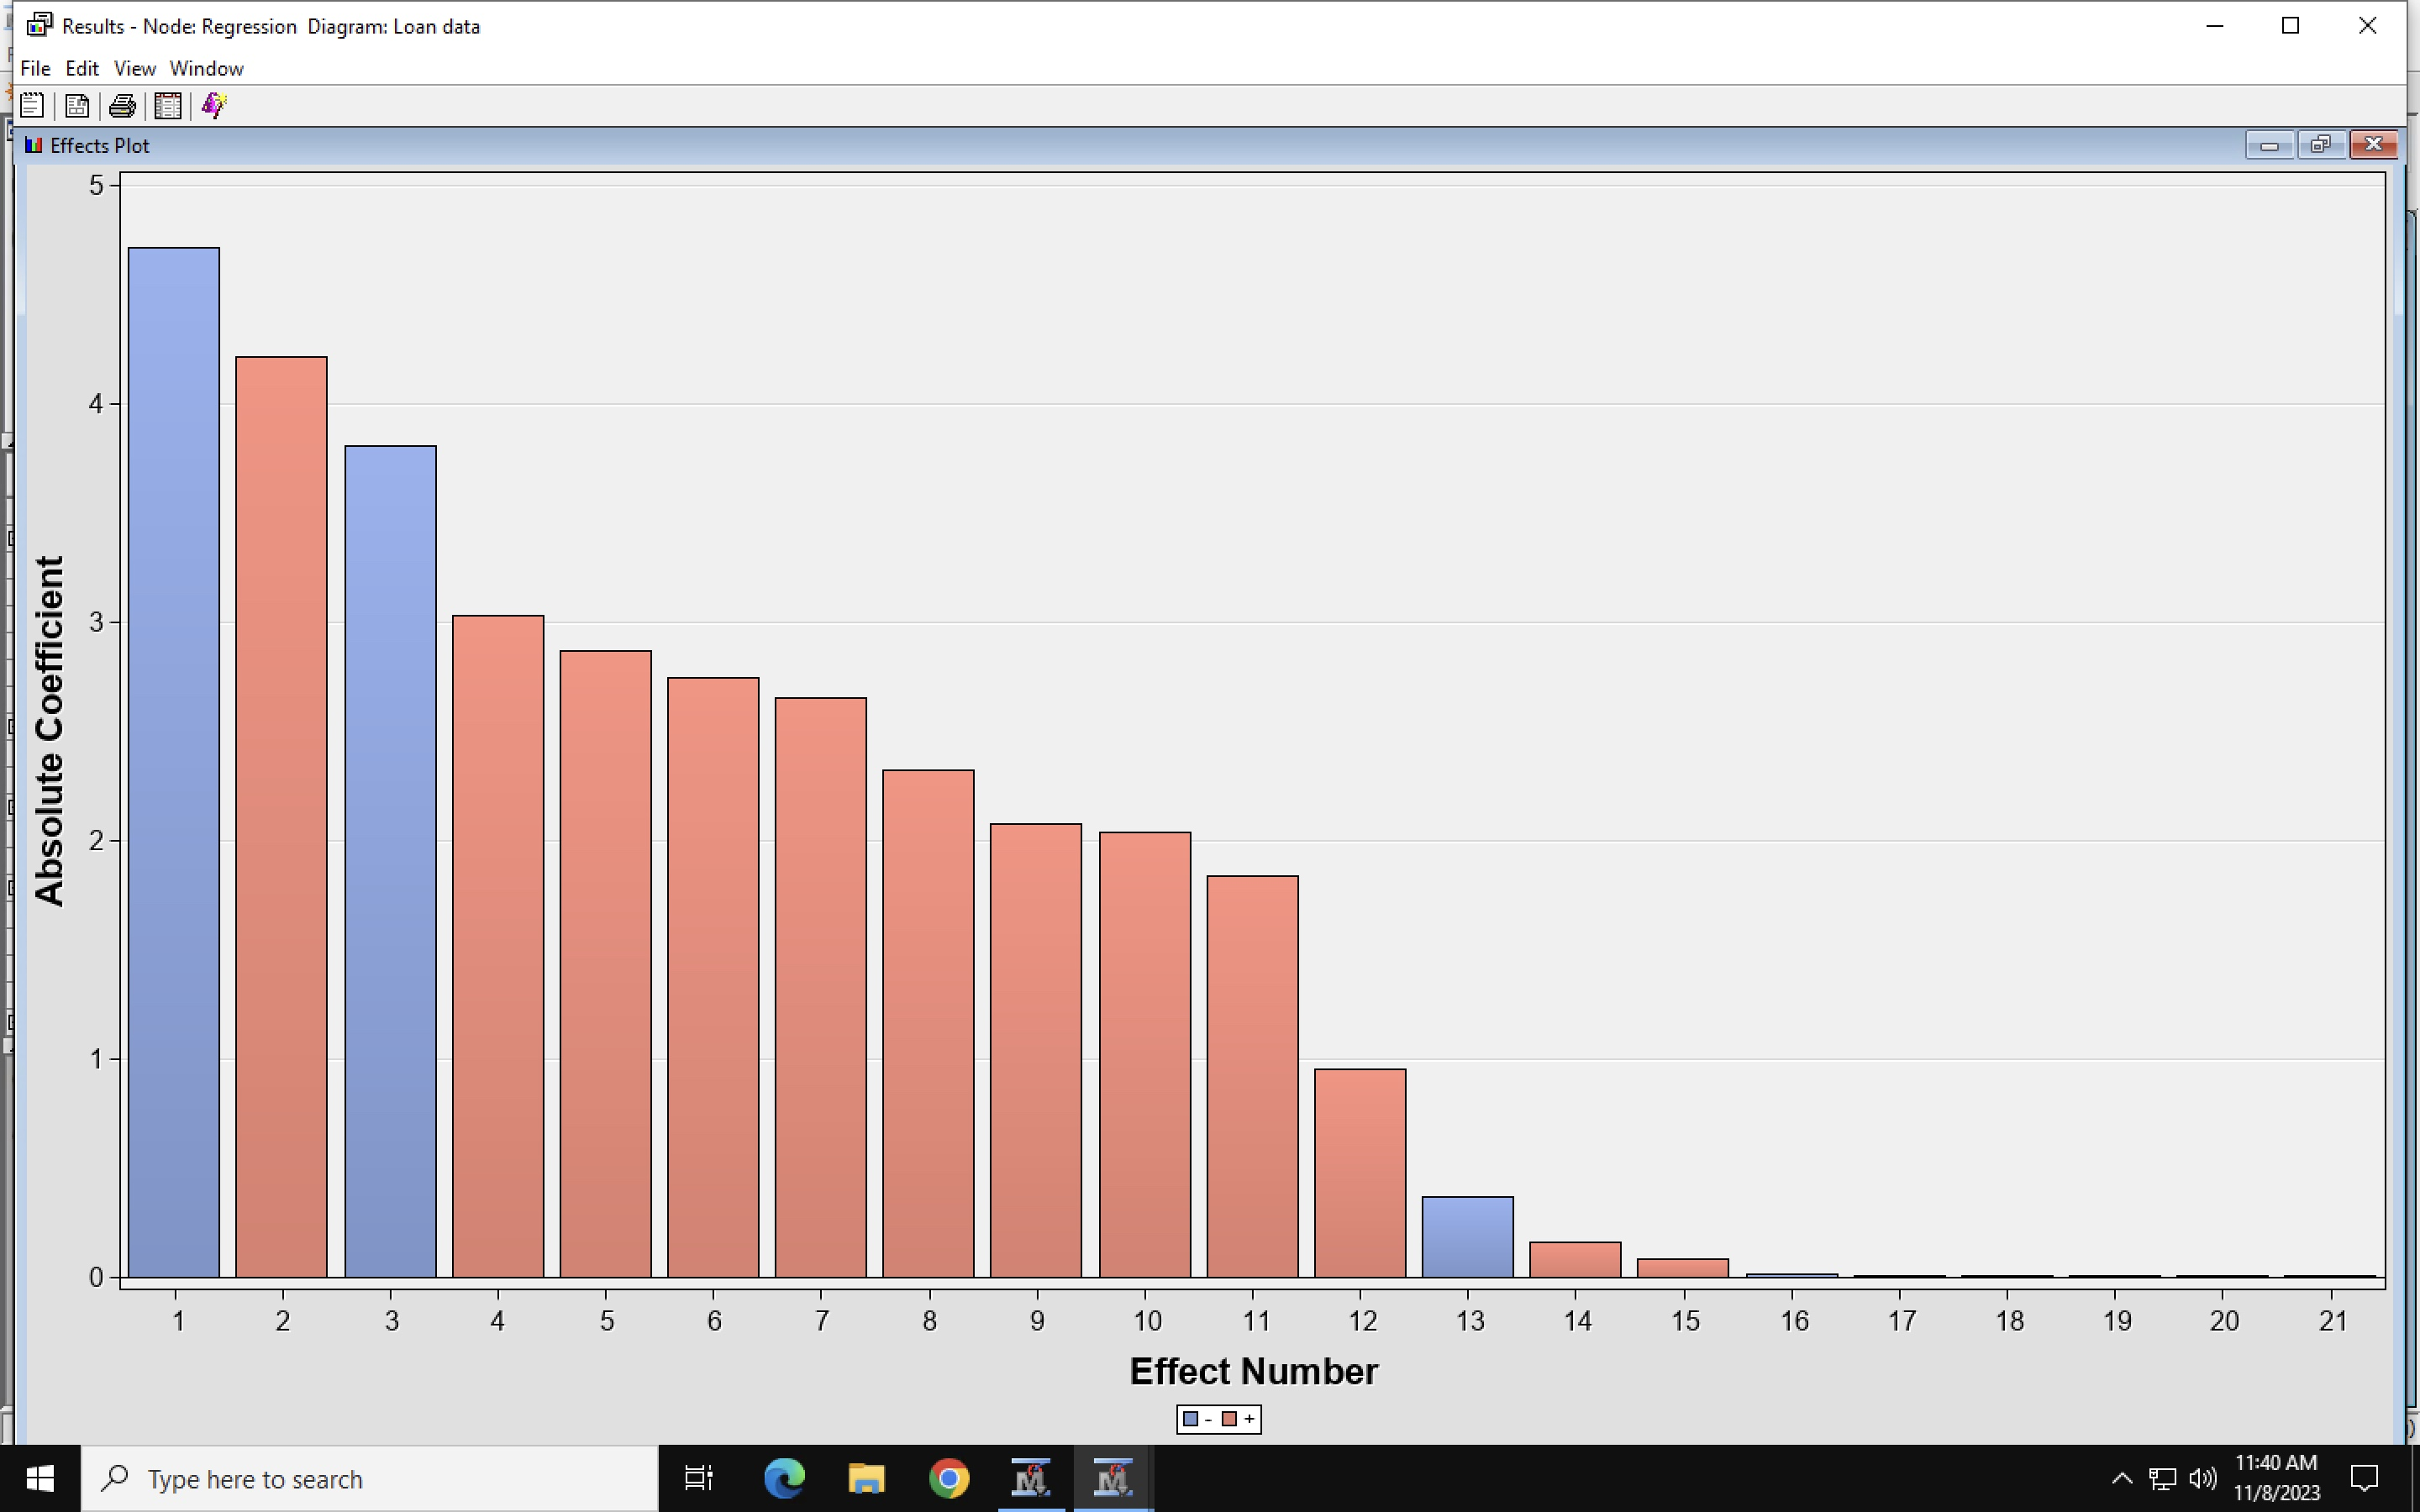
Figure 7: Regression analysis- Absolute coefficient

Slide 16
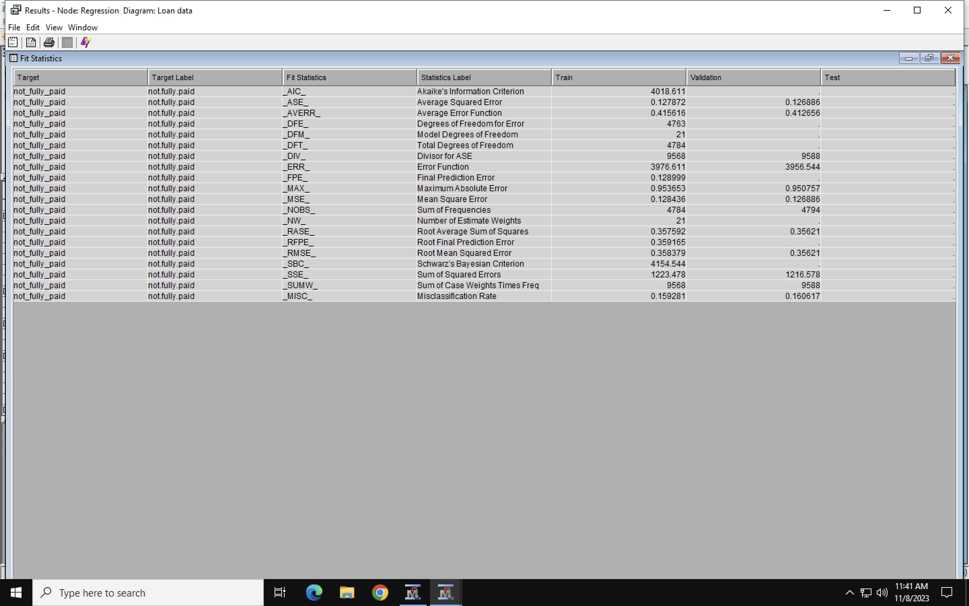
Figure 7: Regression Analysis- Fit Statistics.

Slide 17
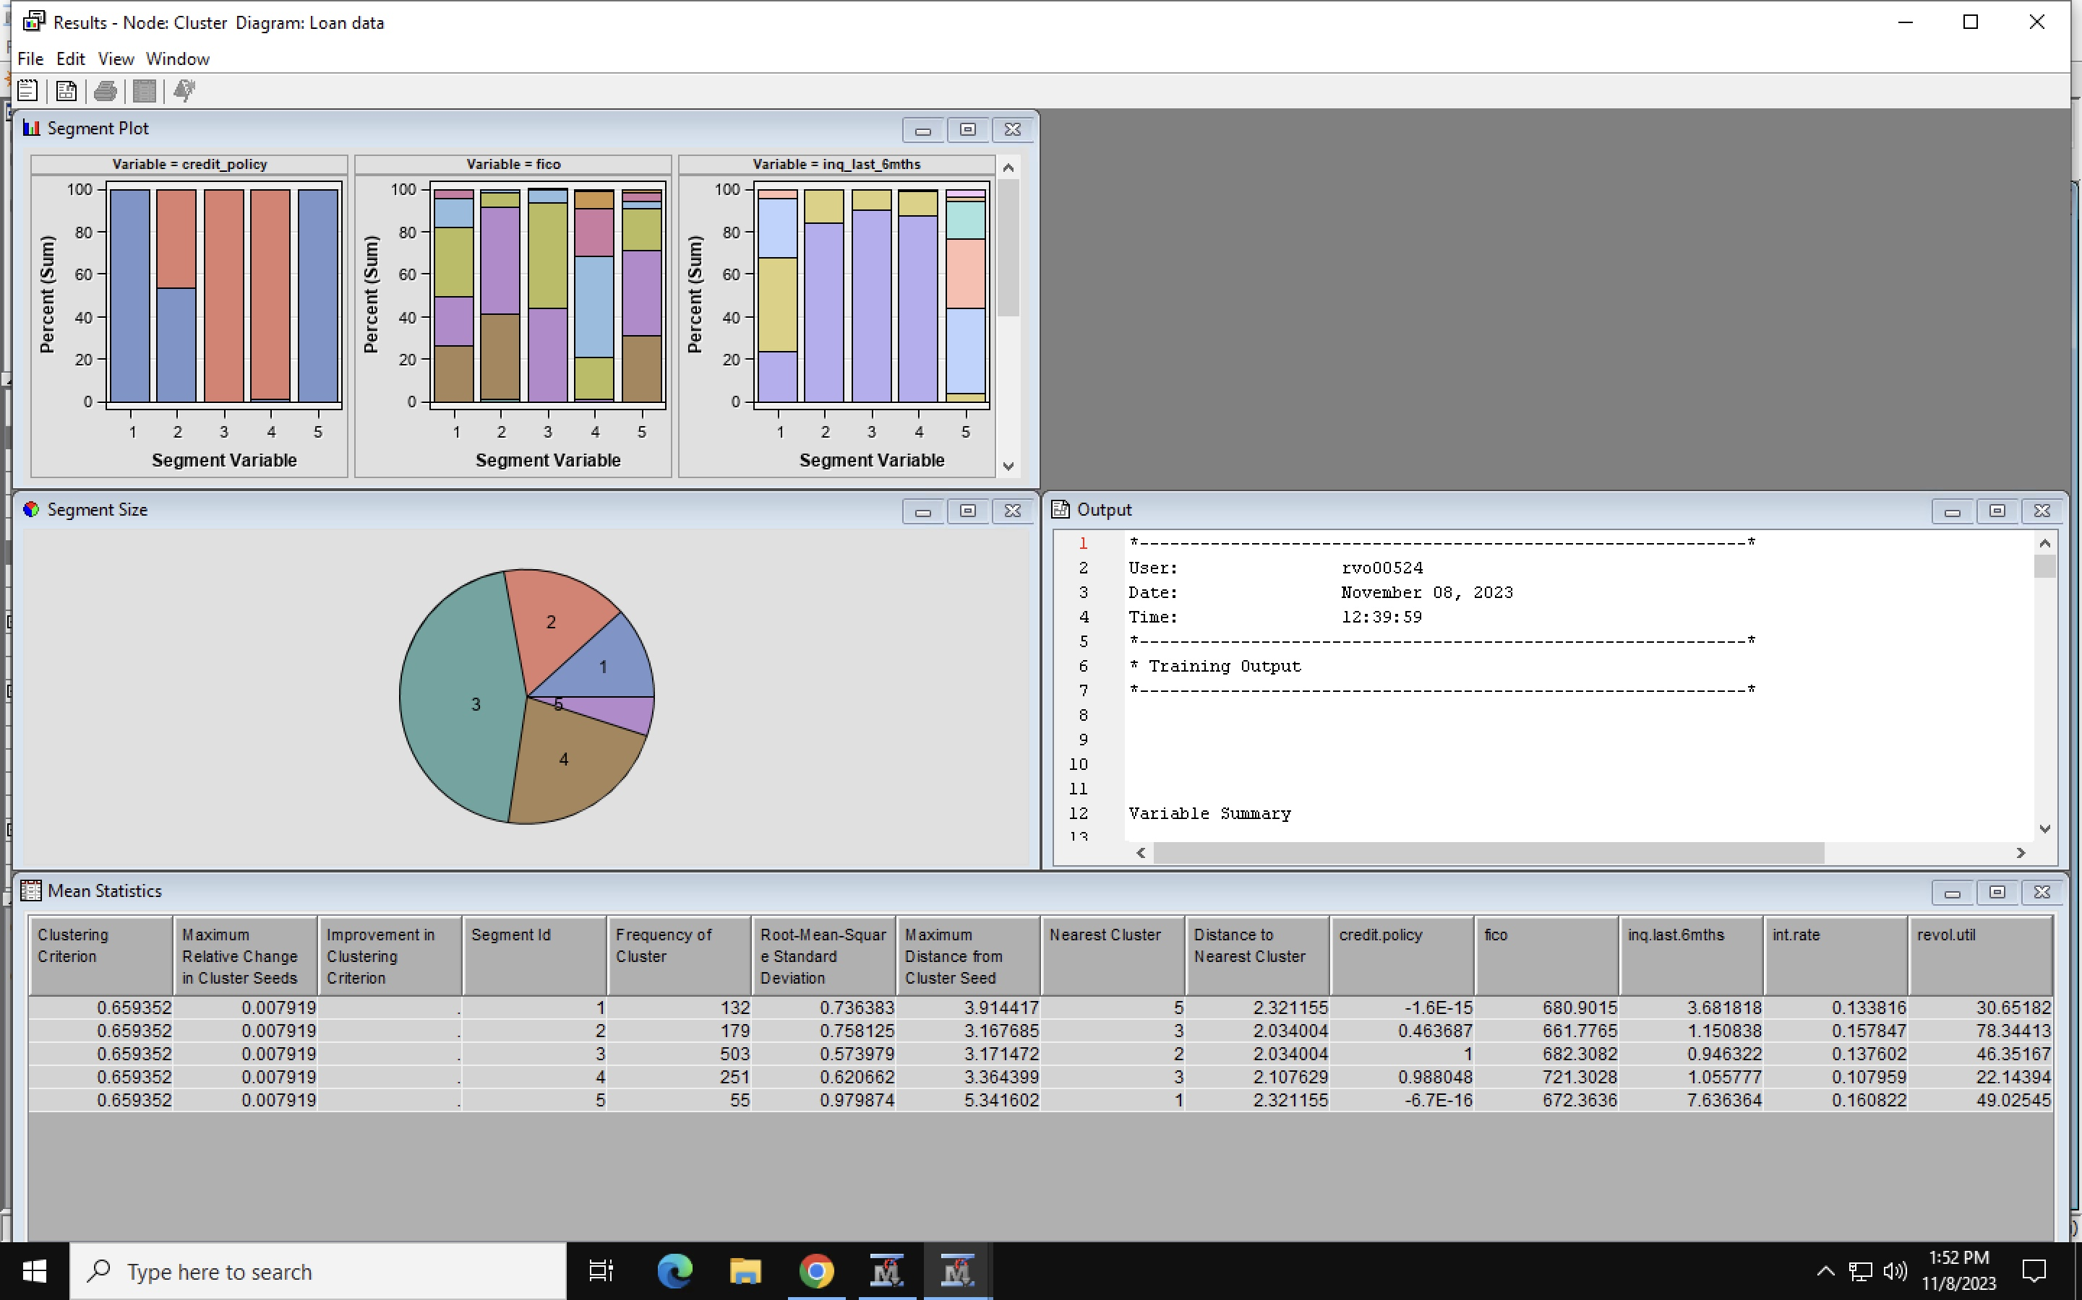
Figure 8: Cluster Analysis.

